Slide 1




ISHIKAWA
TECHNOLOGY
PVT.LTD
ishikawatechnologypvtltd@gmail.com
info@ishikawatechnololy.com
+917409335361,+918221002709

Slide 2


TABLE OF CONTENT
Organization Chart
About Company
Vision
Mission
Our customer
Technology & Expertise
Electrical Automation & Engineering Solutions
Our Machines
Facilities
Contact
ishikawatechnologypvtltd@gmail.com
info@ishikawatechnology.com

Slide 3
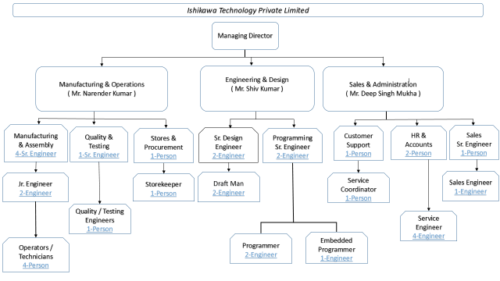

Slide 4


ABOUT COMPANY
• An Engineering solution company formed with a vision to provide an innovative engineering automation &
Integration solution to a large array of industries.
• We are specializes in the field of special purpose machines & automation for a wide range of applications.
• We are experts in different hard core fields like Mechanical, Pneumatics, Hydraulics, Electrical, Automation & robotics, welding fixtures , Go or No Go Gauges .
• No of People : 25
• Company Turnover: 4 Cr.
• Total Area – 6000 Sq. ft.
ishikawatechnologypvtltd@gmail.com
info@ishikawatechnology.com

Slide 5

VISION
Dedicated to delivering high quality machine, innovative automation and solutions. Developing a deep and mutual trust with our Customers, Employees, Vendors, and Partners
ishikawatechnologypvtltd@gmail.com
info@ishikawatechnology.com

Slide 6

MISSION
Provide the highest level of customer satisfaction in the Automation Industry. Continuous improvement, innovation, and diversification in concert with sustaining an entrepreneurial spirit throughout the organization.
ishikawatechnologypvtltd@gmail.com
info@ishikawatechnology.com

Slide 7
























OUR CUSTOMER
KANAK AUTO
ishikawatechnologypvtltd@gmail.com
info@ishikawatechnology.com

Slide 8
TECHNOLOGY & EXPERTISE
❖ Special Purpose Machine
❖ Retrofit Convert
❖ Assembly Line for Automation & Manual Job
❖ Automation concept Design
❖ PLC & HMI Programming
❖ Laser & Engraving Marking
❖ Data Traceability
❖ Conveyor & Lifters
❖ Customized Panel Assembly
❖ GO & NO GO Gauges
❖ Jig & Fixtures Design & development
❖ Precise Fabrication work
❖ End of Line Machines
❖ Robotic Applications
❖ Trolleys & Gravity Chute for Material Transfer
❖ Dry & Water Leak test Machine
❖ Oil Application
❖ Noise Test chambers
❖ Inspection Instruments
❖ Contact and wire crimping machine
❖ Element crimping machine
❖ FFT Fixtures
❖ Final Functional Testing Machine
❖ Wire Harness machines,
❖ Endurance Testing Machine
ishikawatechnologypvtltd@gmail.com
info@ishikawatechnology.com

Slide 9





ELECTRICAL AUTOMATION & ENGINEERING SOLUTIONS
•Servo Motors & Drive
•VFD
•Motion Controllers
•Industrial Robot
System Integrator
•PLC
•Servo Motors & Drive
All Sensor & Vision System
•HMI
•Industrial PC
•Flat Panel Display
•Software Solution & SCADA
•IOT Solution
•Data Traceability
•PLC
•HMI
•Servo Motors & Drive
ishikawatechnologypvtltd@gmail.com
info@ishikawatechnology.com

Slide 10
OUR MACHINES
ishikawatechnologypvtltd@gmail.com
info@ishikawatechnology.com

Slide 11
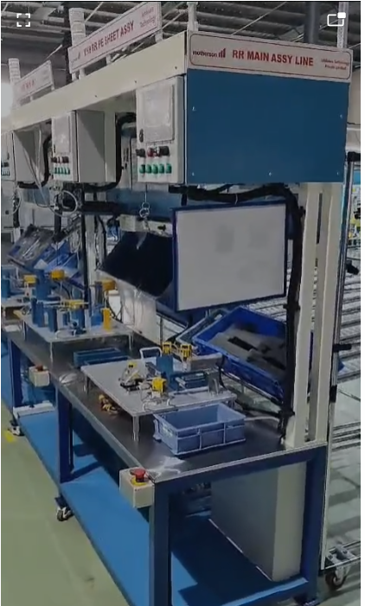
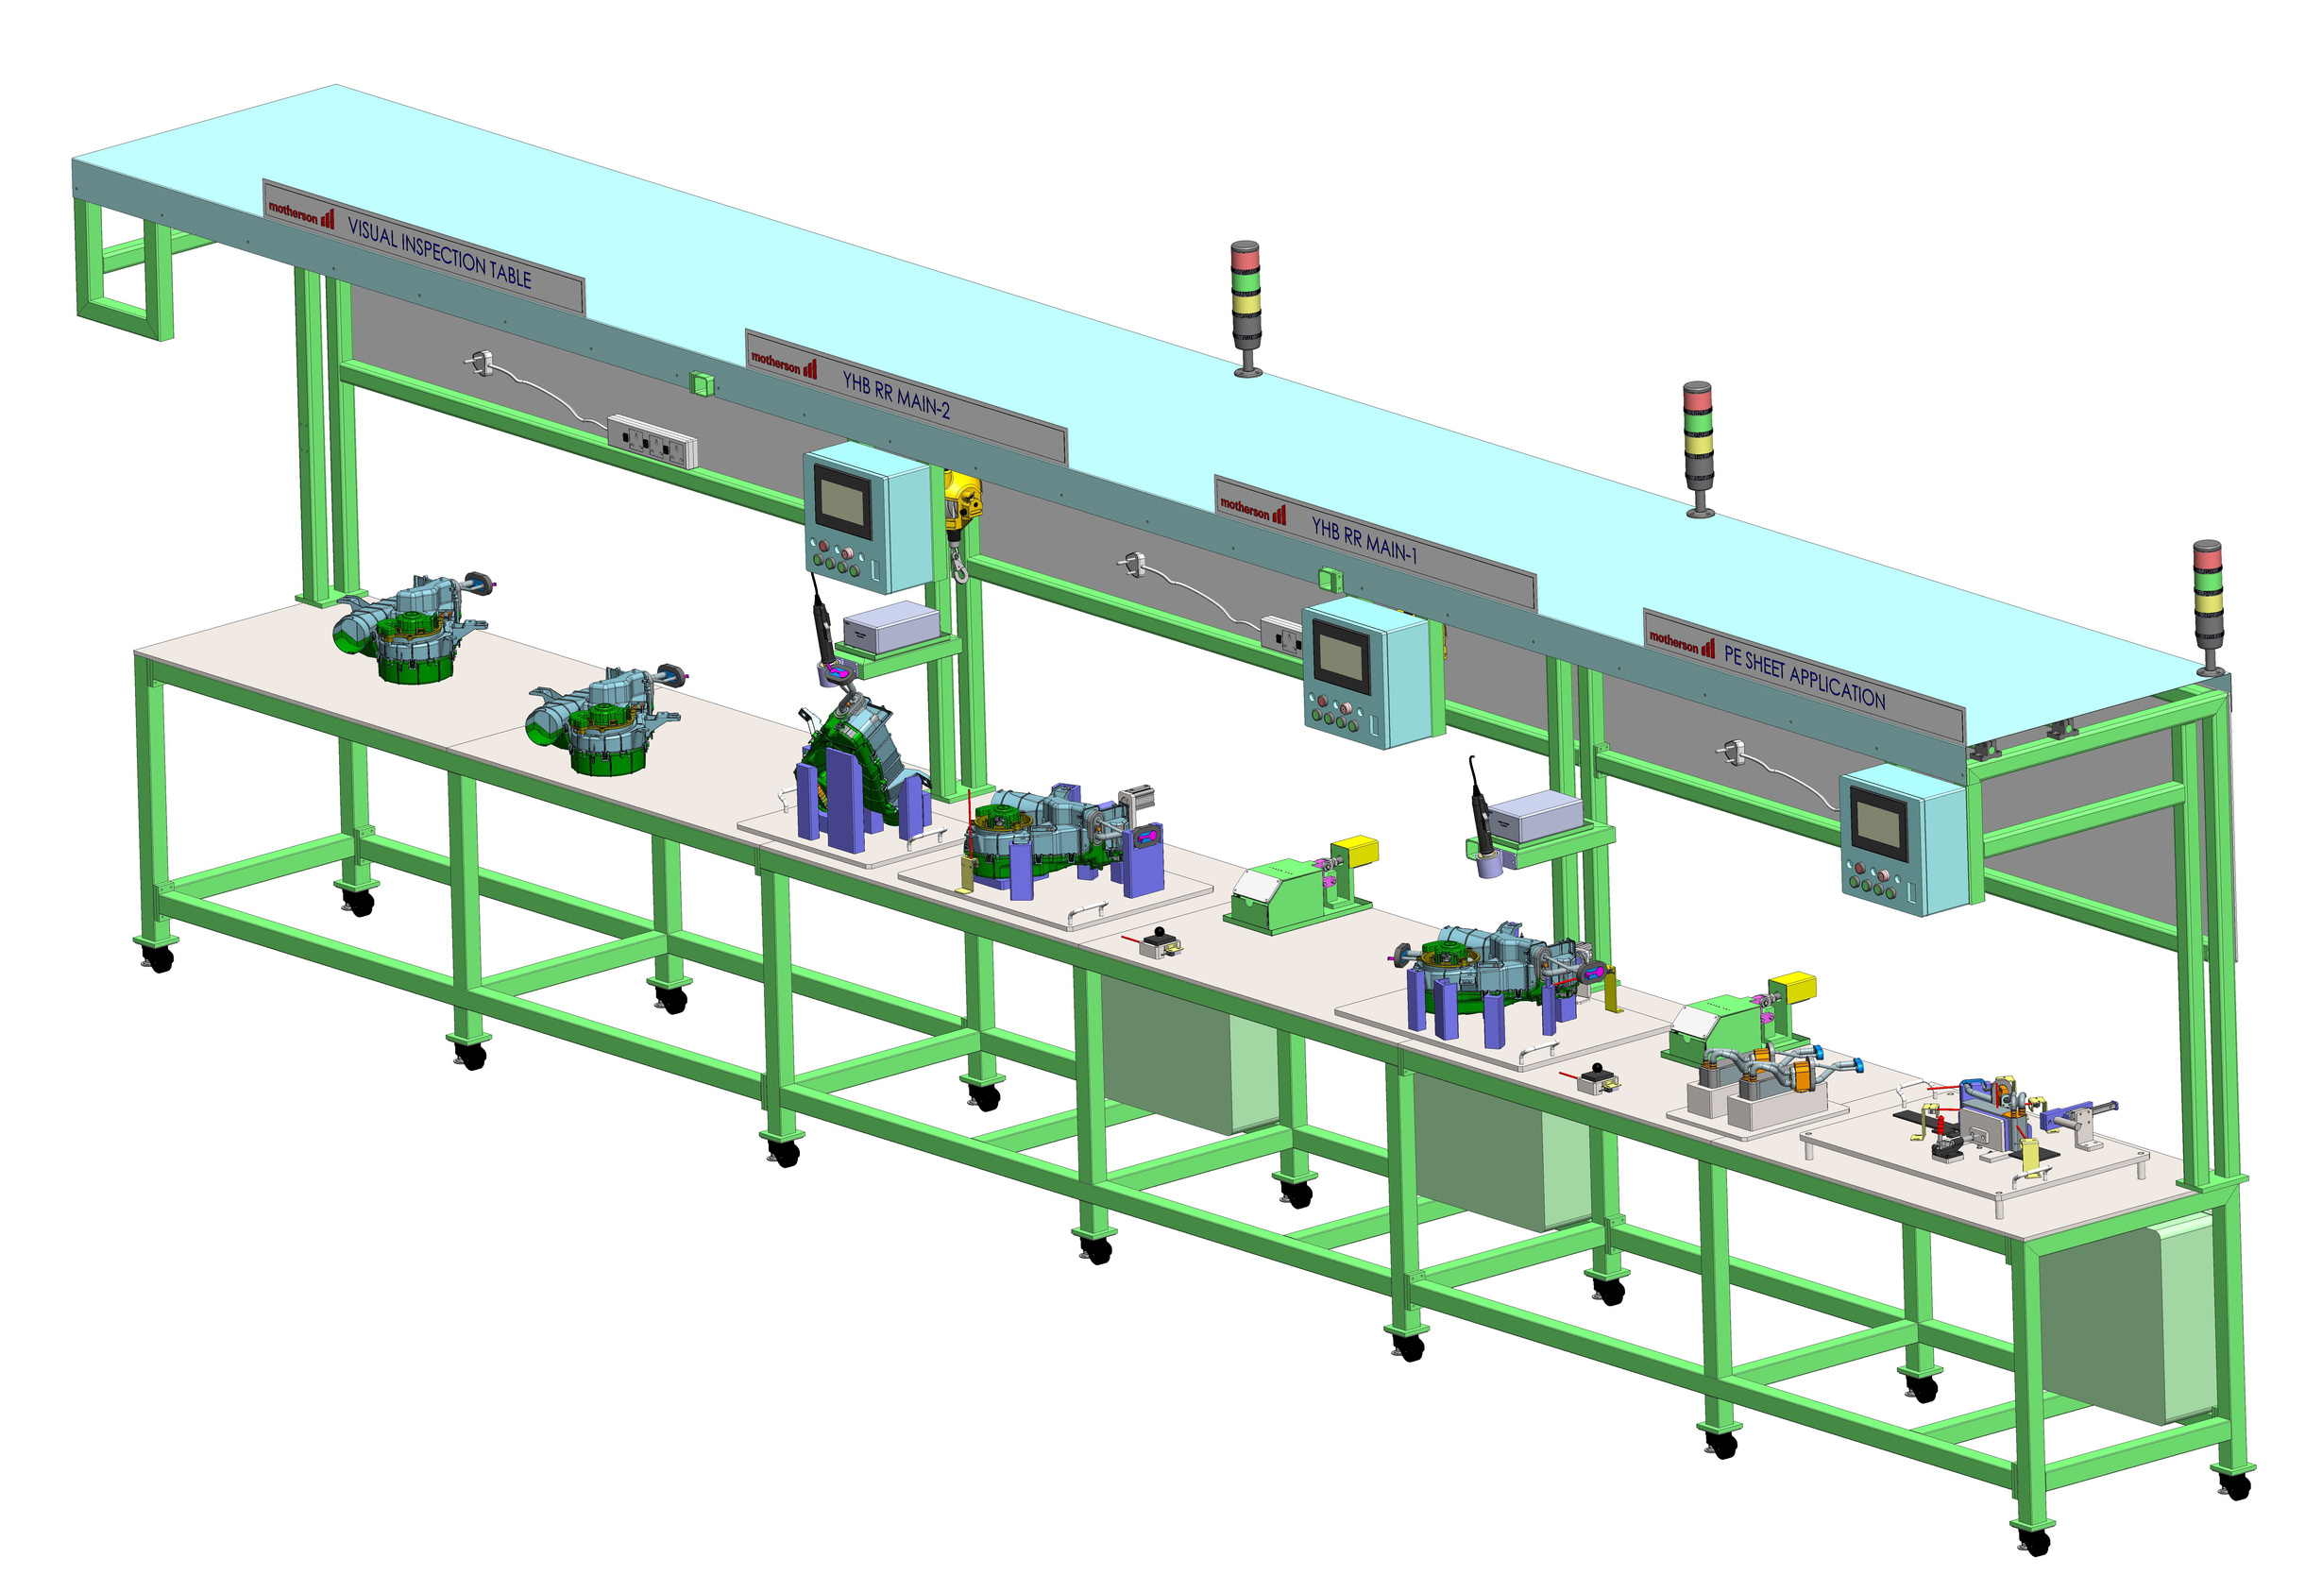
Machine Name-
HVAC ASSEMBALY LINE
ishikawatechnologypvtltd@gmail.com
info@ishikawatechnology.com

Slide 12
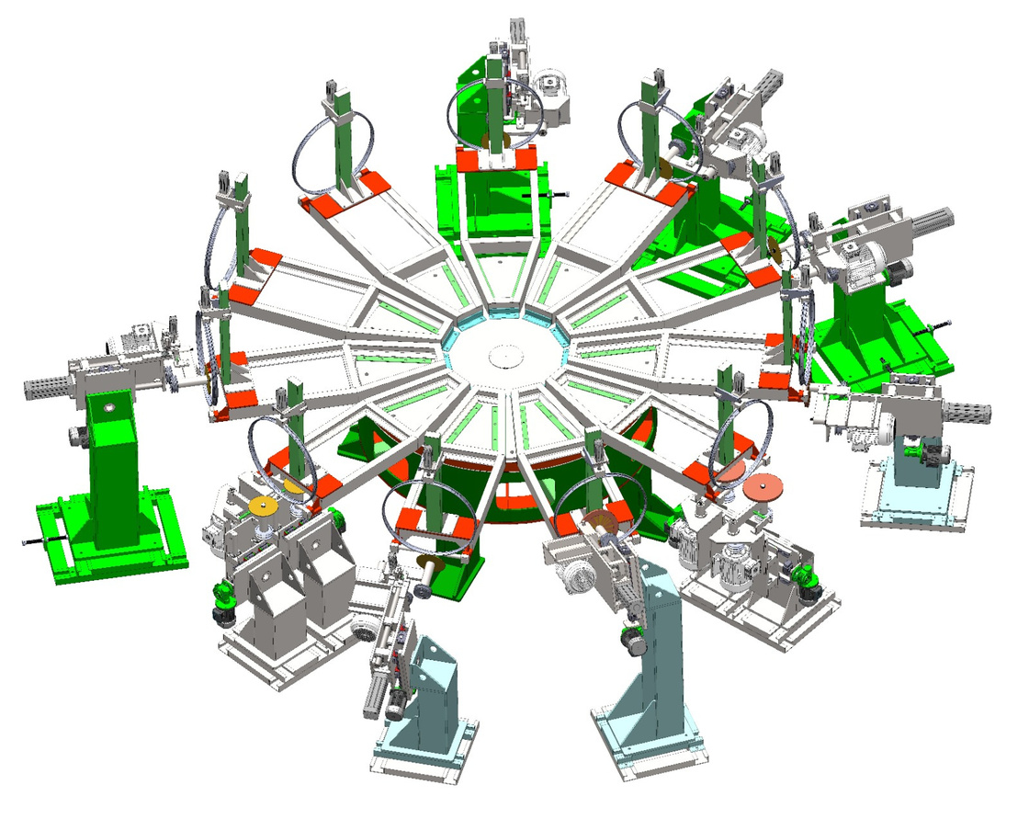
Machine Name-
RIM GRINDING ROTARY
MACHINE FOR HERO CYCLE
ishikawatechnologypvtltd@gmail.com
info@ishikawatechnology.com

Slide 13
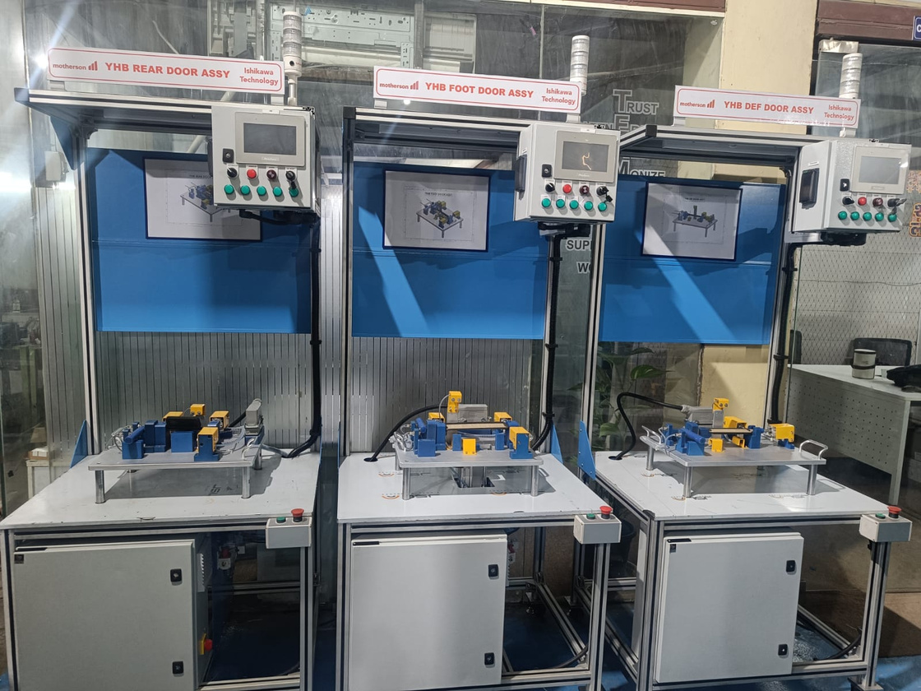
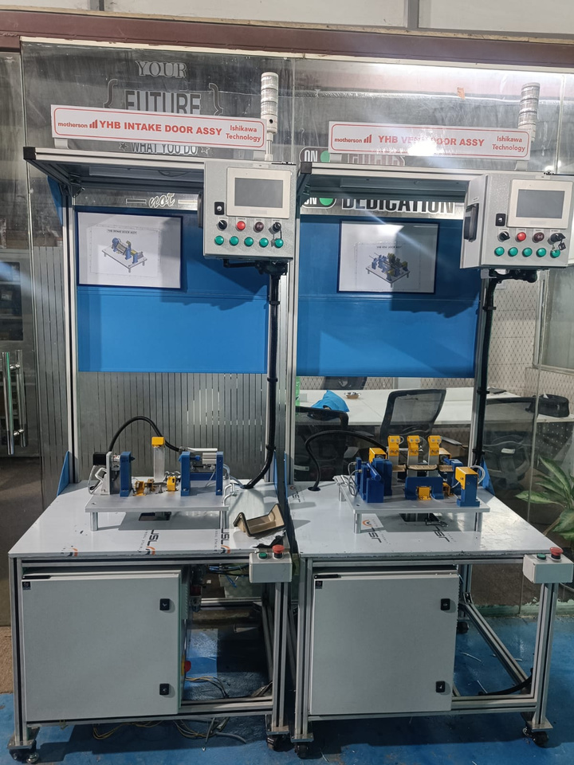
Machine Name-
R R DOOR ASSEMBALY LINE
ishikawatechnologypvtltd@gmail.com
info@ishikawatechnology.com

Slide 14
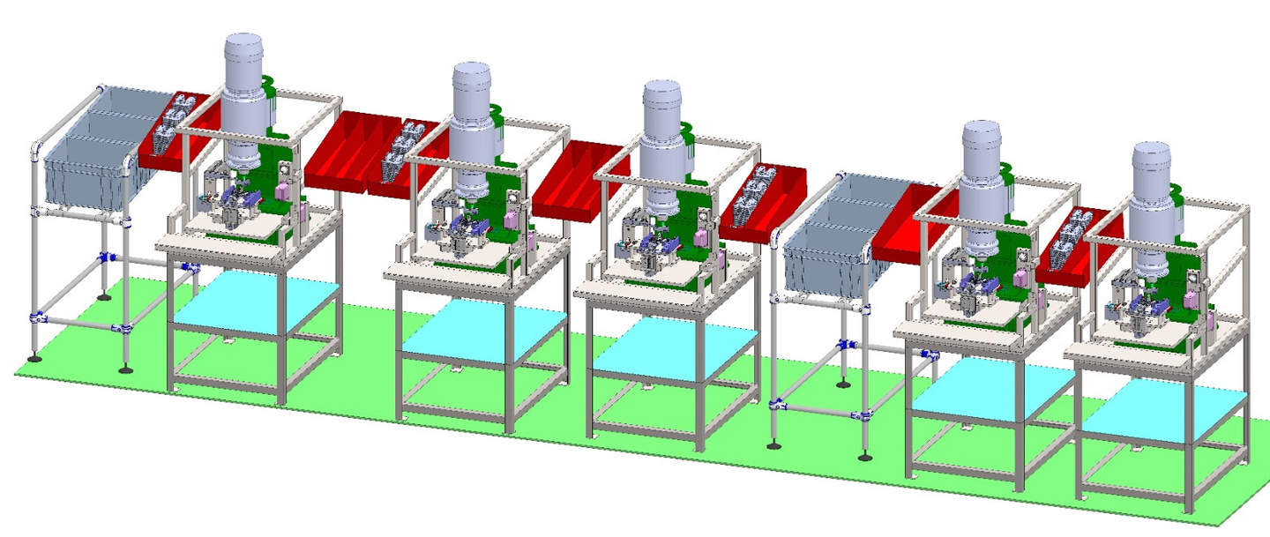
Machine Name-
2 POSITION SEAT LATCH LINE
SEAT LOCK ASSEMBALY LINE
ishikawatechnologypvtltd@gmail.com
info@ishikawatechnology.com

Slide 15
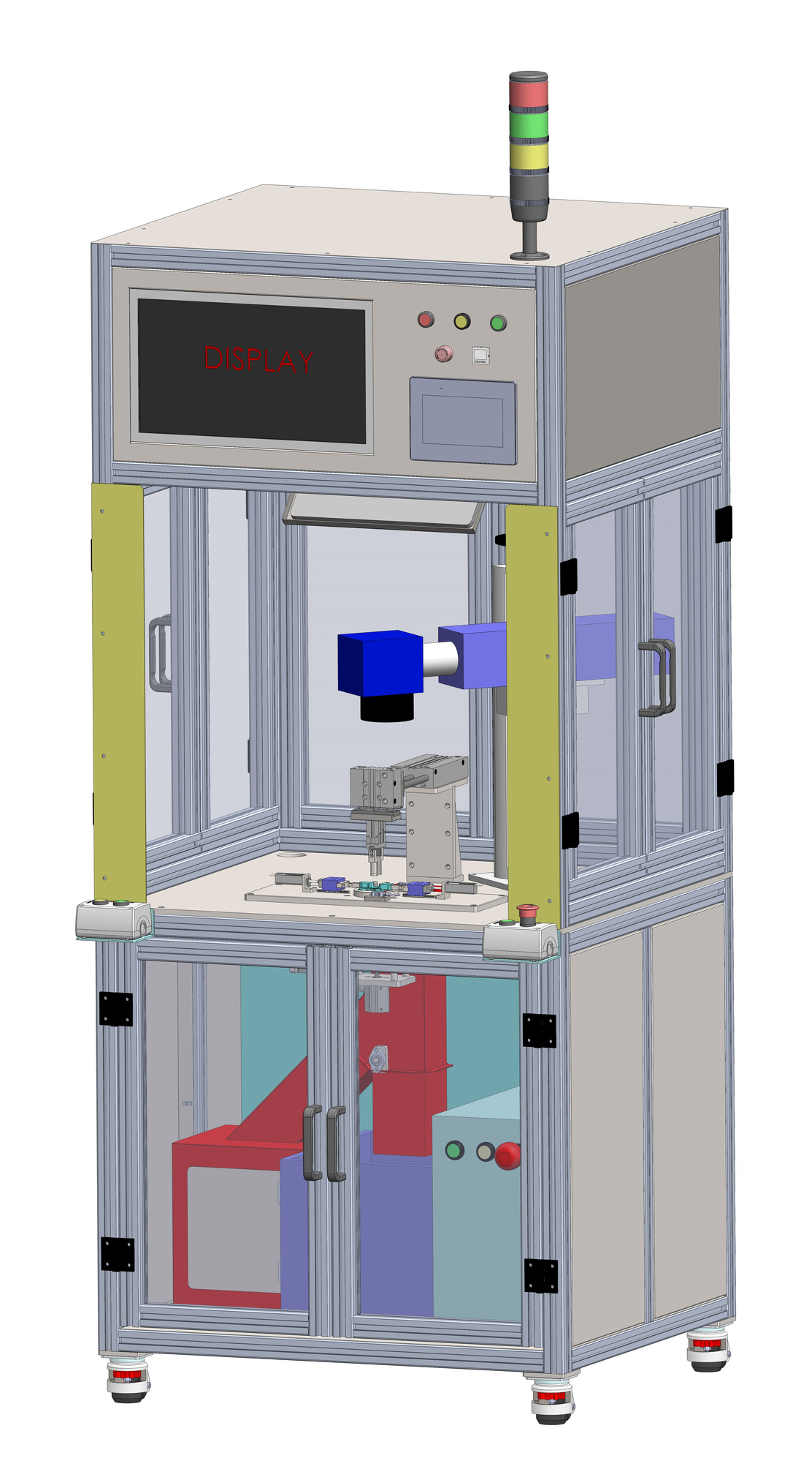
Machine Name-
BRUSH HOLDER GAUGE CHECKING & LASER MARKING MACHINE
ishikawatechnologypvtltd@gmail.com
info@ishikawatechnology.com

Slide 16
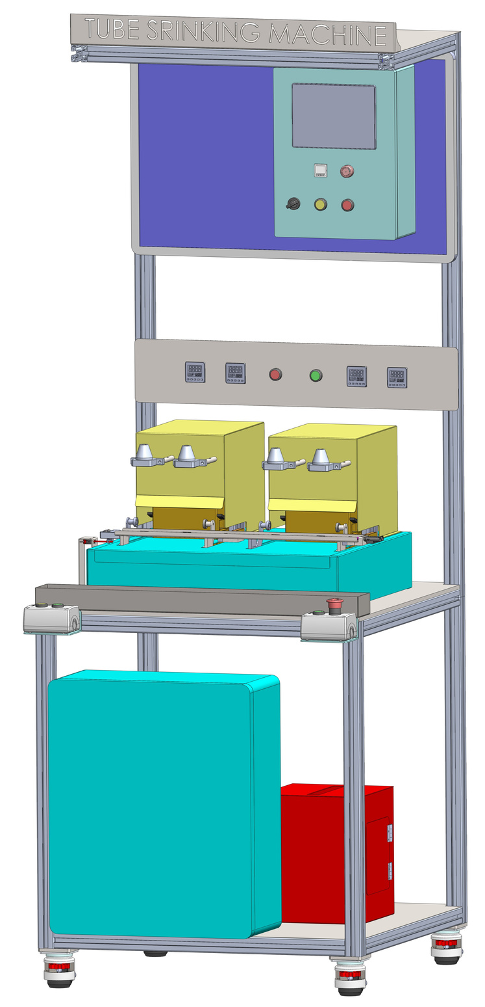
Machine Name-
TUBE SHRINKING MACHINE
ishikawatechnologypvtltd@gmail.com
info@ishikawatechnology.com

Slide 17
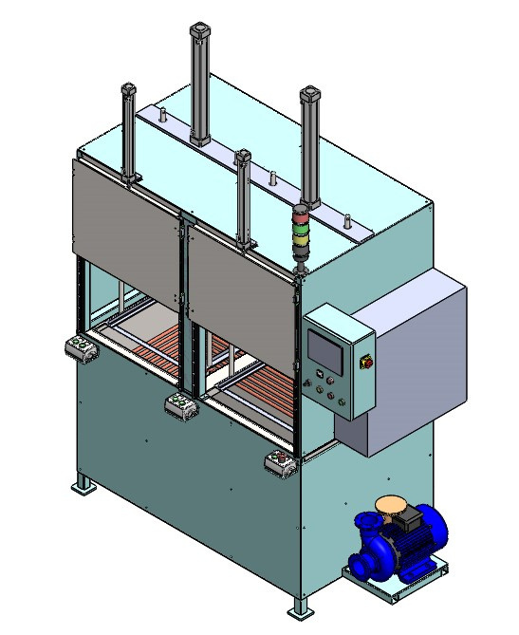
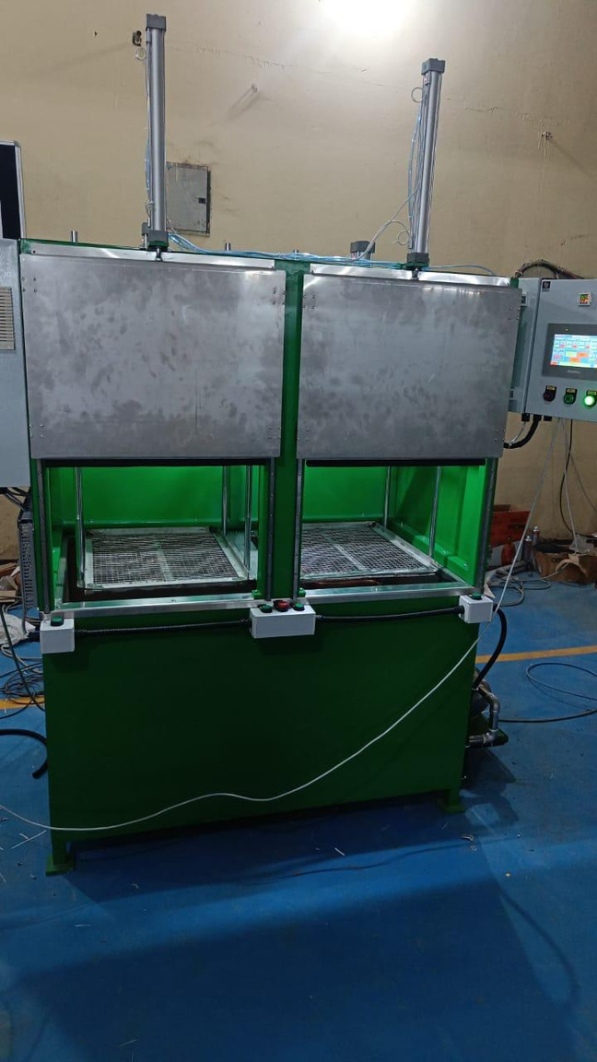
Machine Name-
WASHING MACHINE
ishikawatechnologypvtltd@gmail.com
info@ishikawatechnology.com

Slide 18
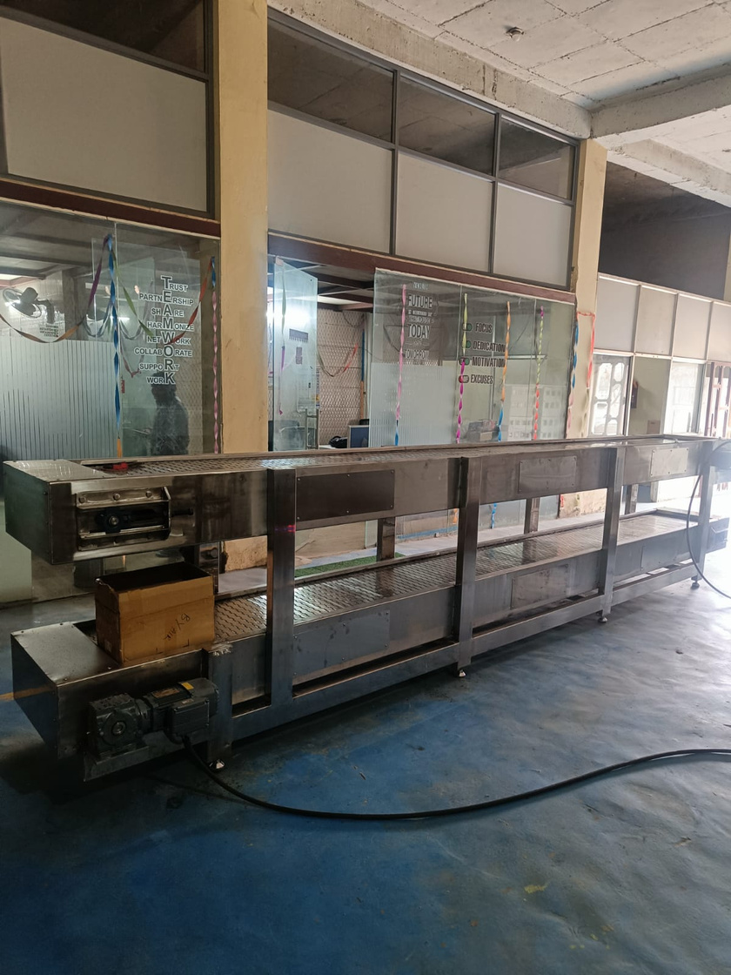
Machine Name-
DOUBLE DECKER CHAIN CONVEYOR
Application – .
Part Moving
ishikawatechnologypvtltd@gmail.com
info@ishikawatechnology.com

Slide 19
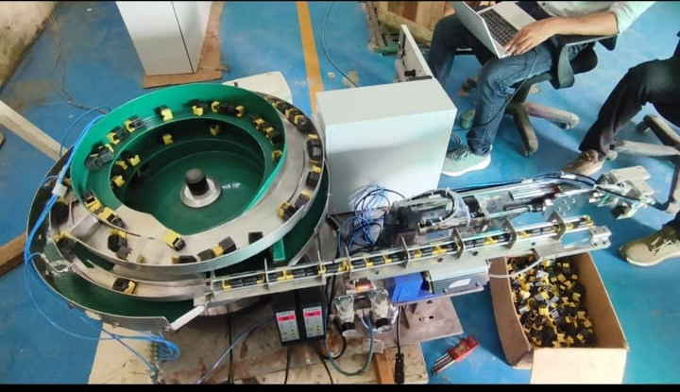
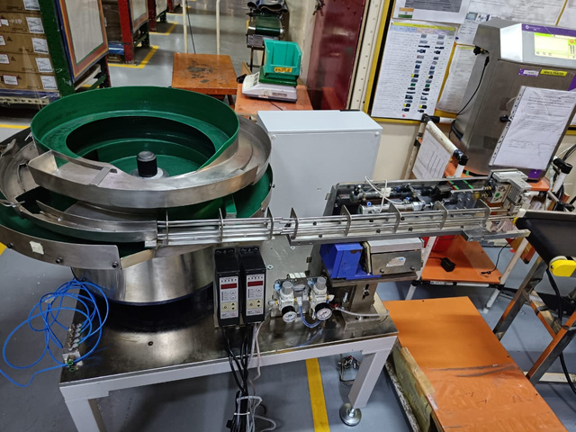
UAE SHARJAH PROJECT(MSEL MOTHERSON)
Machine Name-
BOWL FEEDER WITH AUTOMATIC
PICK & PLACE
ishikawatechnologypvtltd@gmail.com
info@ishikawatechnology.com

Slide 20
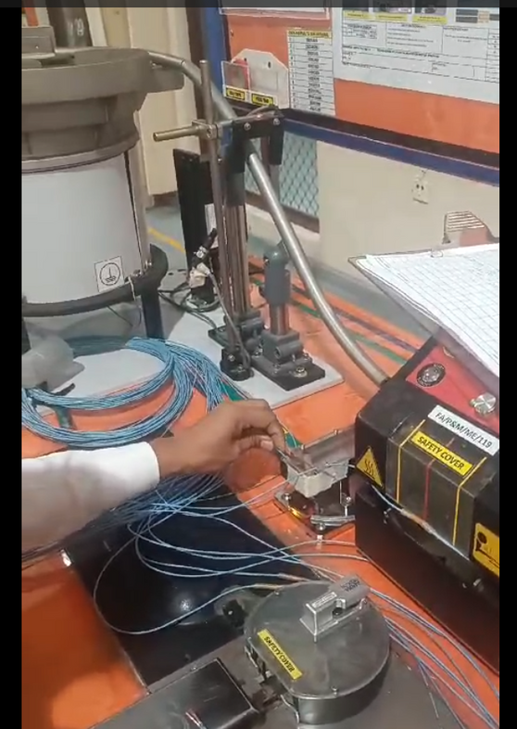
UAE SHARJAH PROJECT(MSEL MOTHERSON)
Machine Name-
HST FIDDING WITH BOWL FEEDER
ishikawatechnologypvtltd@gmail.com
info@ishikawatechnology.com

Slide 21
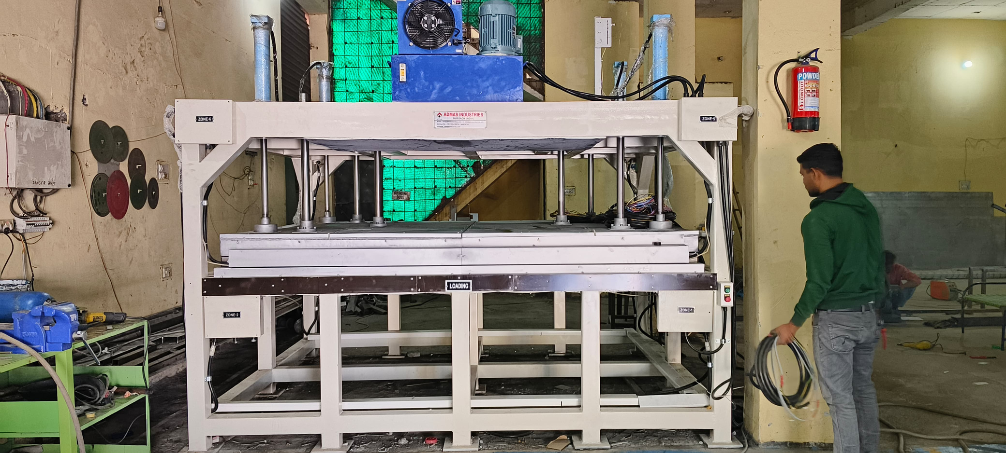
Machine Name-
HOT PLATE MACHINE
Application – .
For Carpet Heating
ishikawatechnologypvtltd@gmail.com
info@ishikawatechnology.com

Slide 22
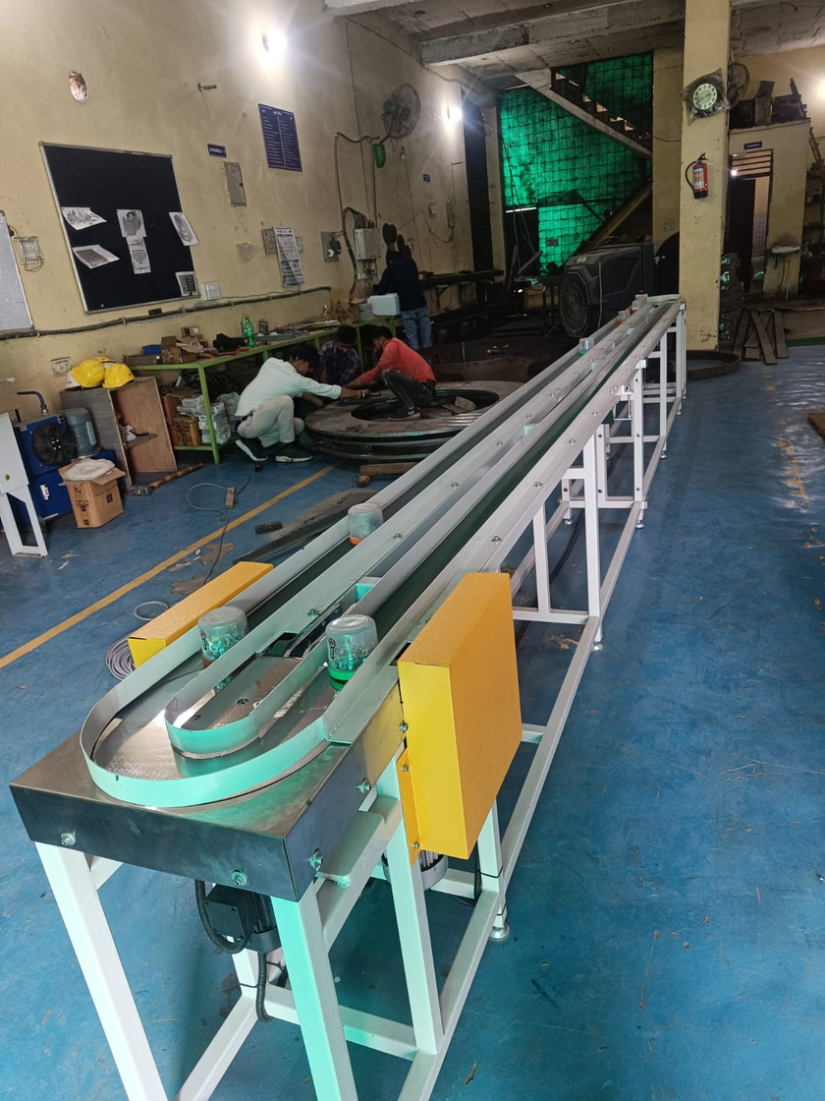
Machine Name
LUBE OIL FILTER ASSEMBALY LINE
ishikawatechnologypvtltd@gmail.com
info@ishikawatechnology.com

Slide 23
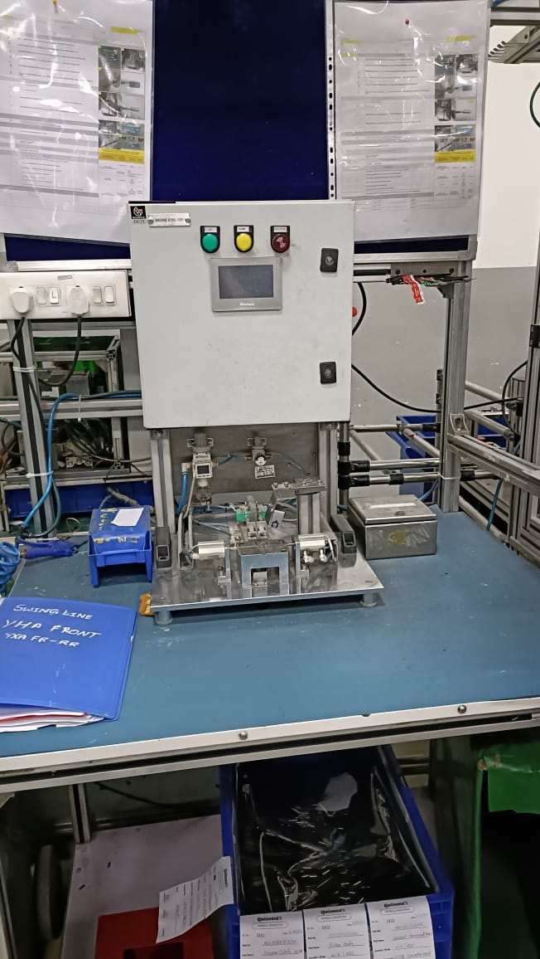
Machine Name-
POLARITY CHECKING MACHINE
Application – .
CONNECTOR TERMINAL CHECKING FIXTURE WITH PROBE
ishikawatechnologypvtltd@gmail.com
info@ishikawatechnology.com

Slide 24
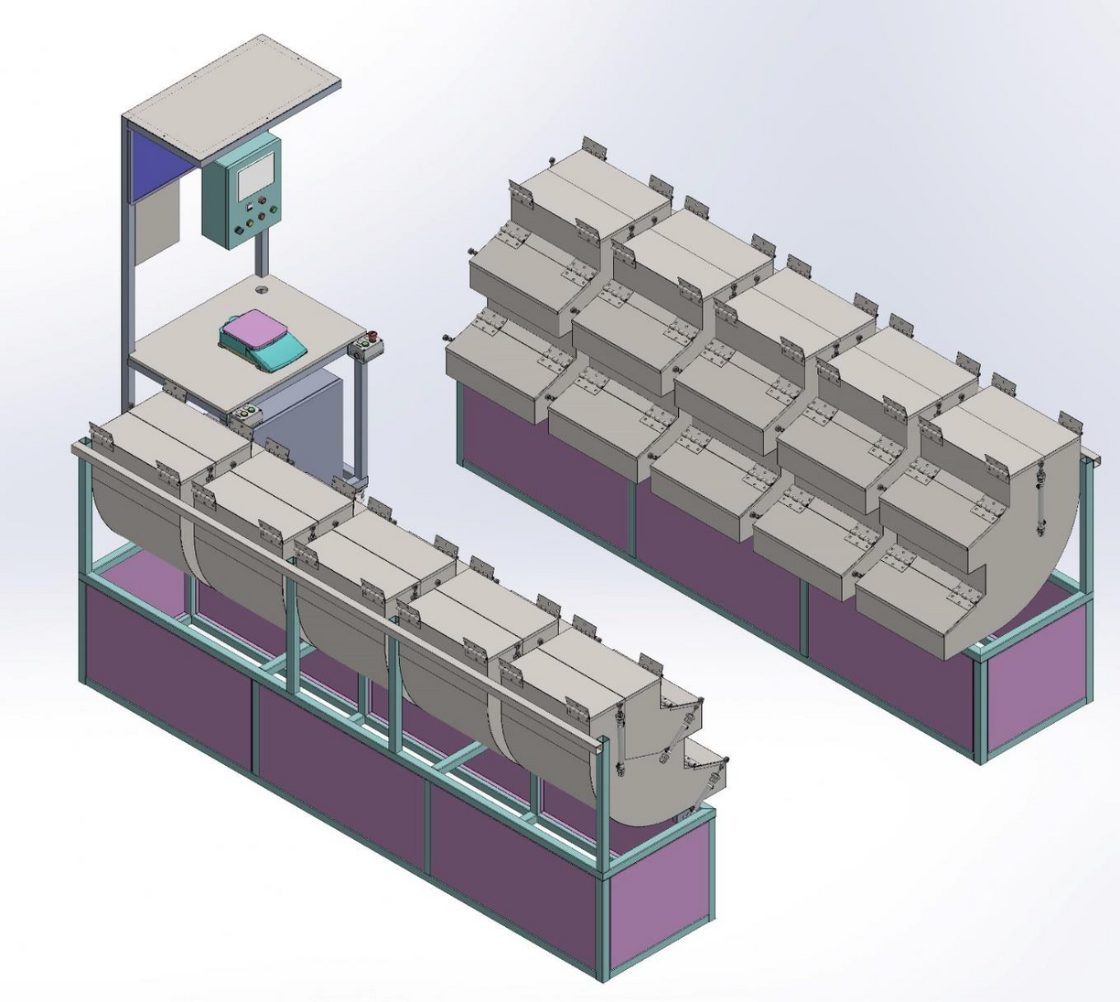
Machine Name-
CHEMICAL MIXING MACHINE
Application – .
ONE BY ONE CHEMICAL COLLECT
FULL AUTOMATIC LINE
ishikawatechnologypvtltd@gmail.com
info@ishikawatechnology.com

Slide 25
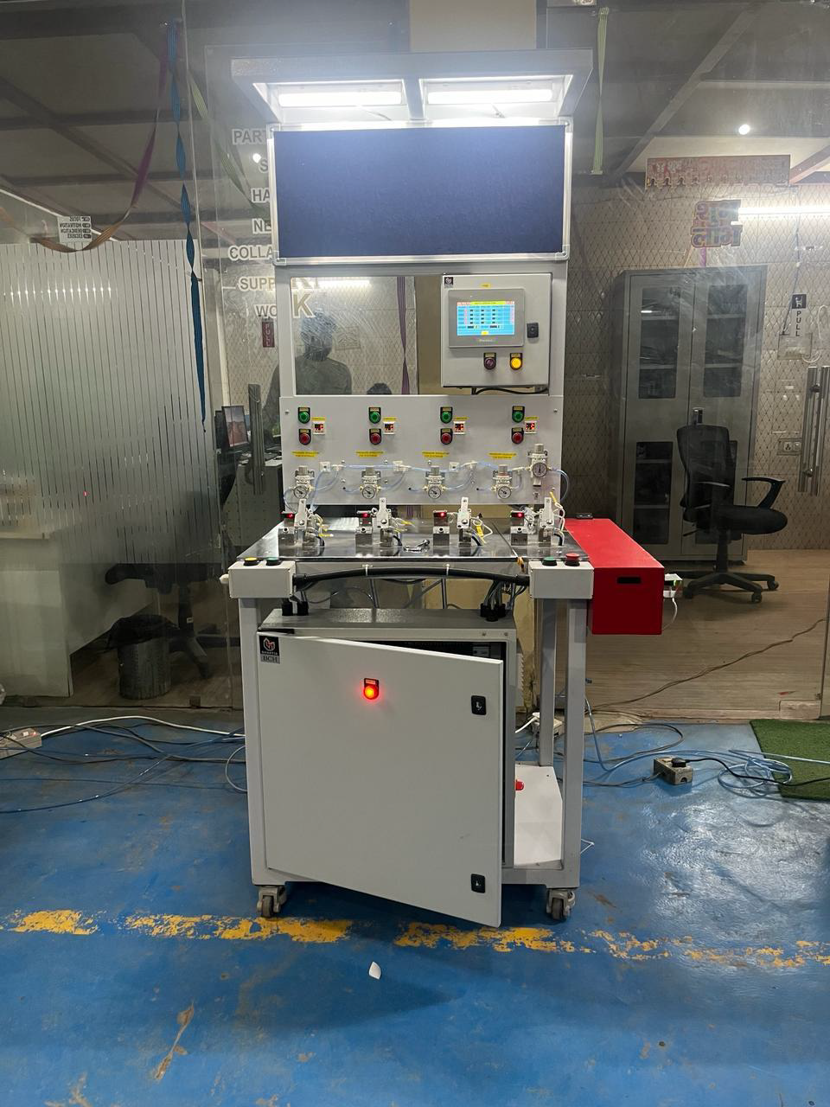
Machine Name-
LEAK TESTING MACHINE
Application – .
OIL GAUGE LEAK TESTING MACHINE
ishikawatechnologypvtltd@gmail.com
info@ishikawatechnology.com

Slide 26
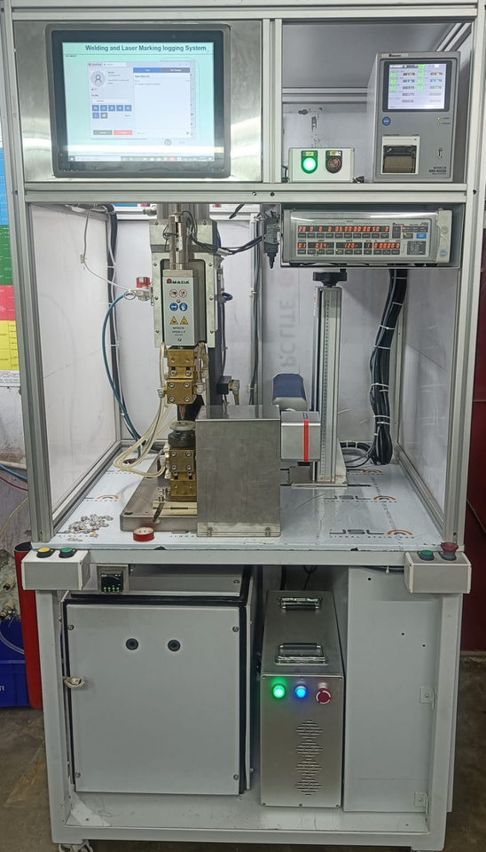
Machine Name-
SPOT WELDING MACHINE
Application – .
WELDING THE PART WITH HELP OF AMADA CONTROLLER AND THEN MARKS THE PART WITH LASER MARKING MACHINE AND SAVE THE DATA OF THE PART IN IPC
ishikawatechnologypvtltd@gmail.com
info@ishikawatechnology.com

Slide 27
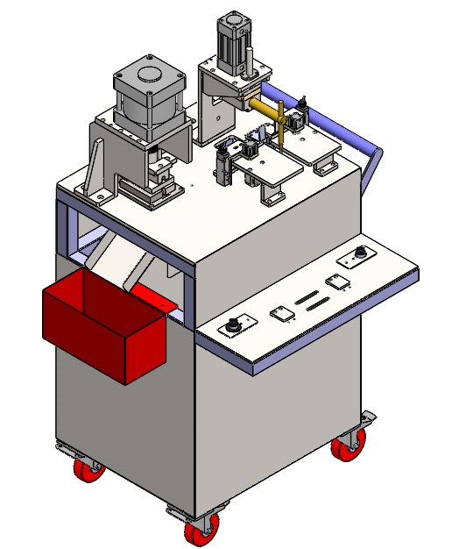
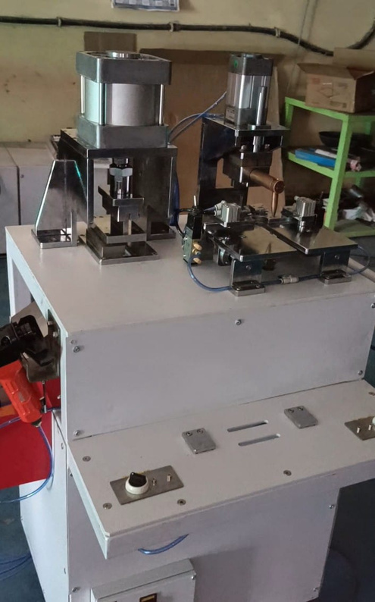
Machine Name-
SPOT WELDING & CUTTING MACHINE
ishikawatechnologypvtltd@gmail.com
info@ishikawatechnology.com

Slide 28
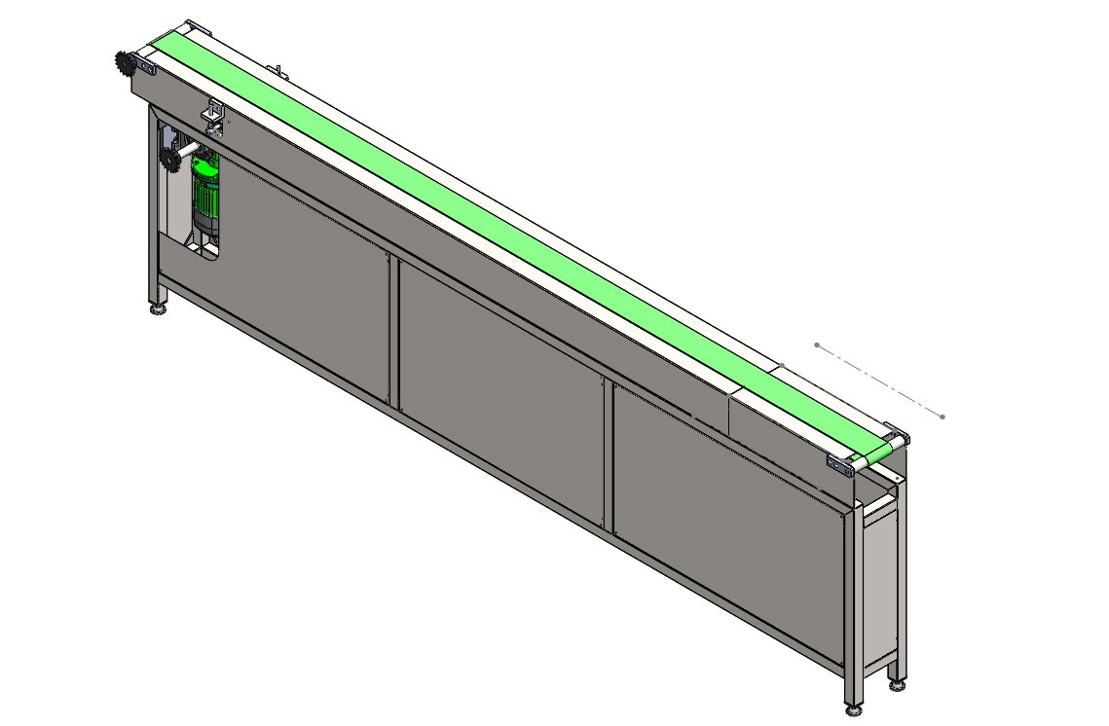
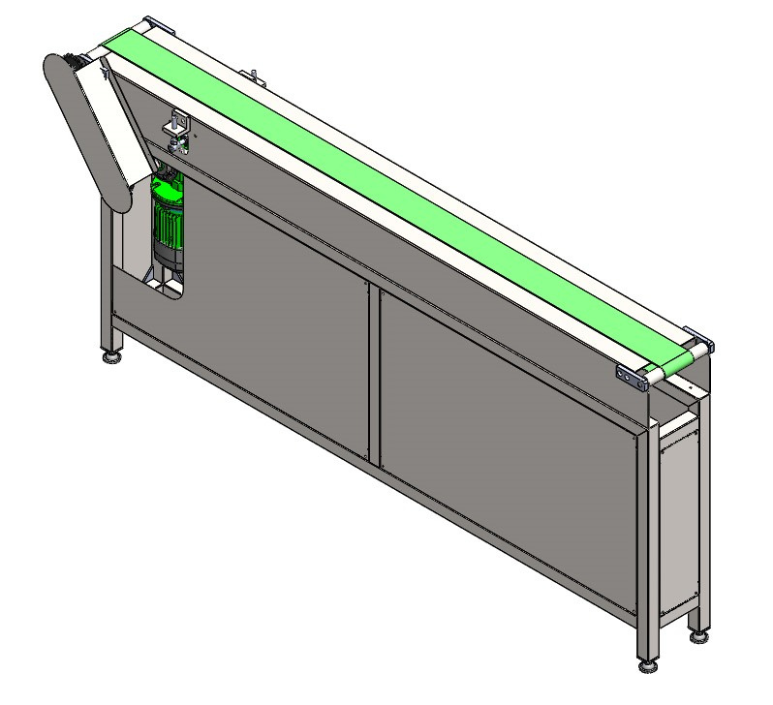
Machine Name-
PART TRANSFER
CONVEYOR
ishikawatechnologypvtltd@gmail.com
info@ishikawatechnology.com

Slide 29
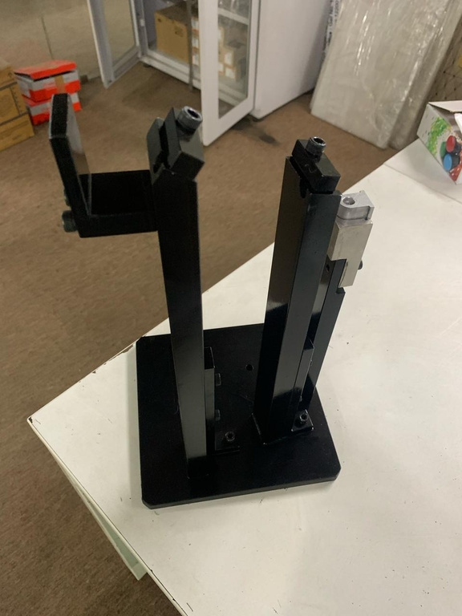
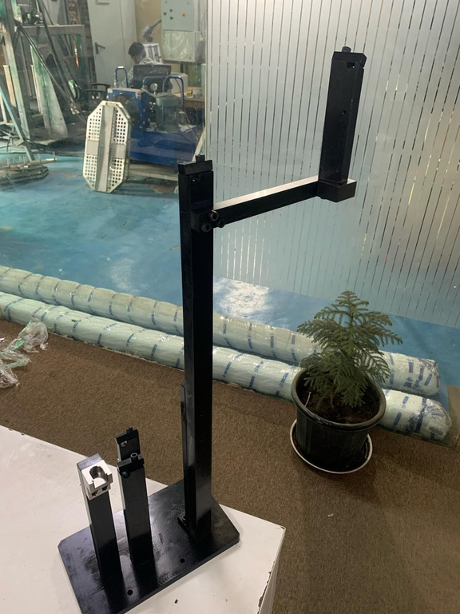
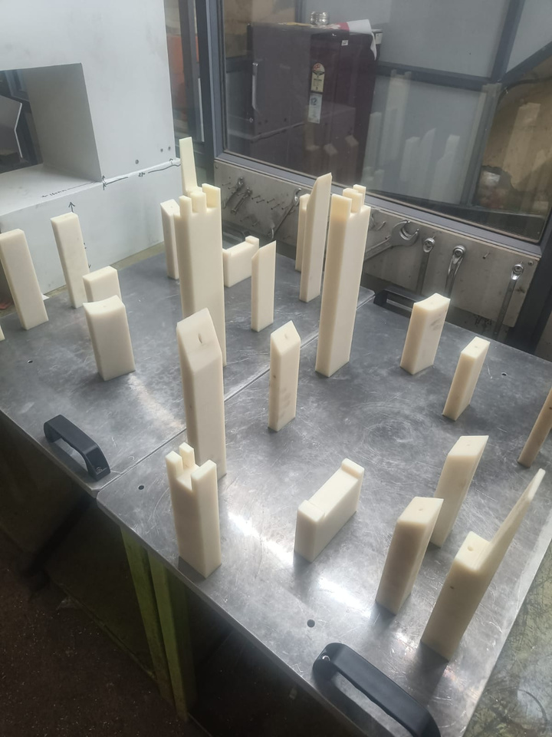
Machine Name-
Jig & fixtures
ishikawatechnologypvtltd@gmail.com
info@ishikawatechnology.com

Slide 30
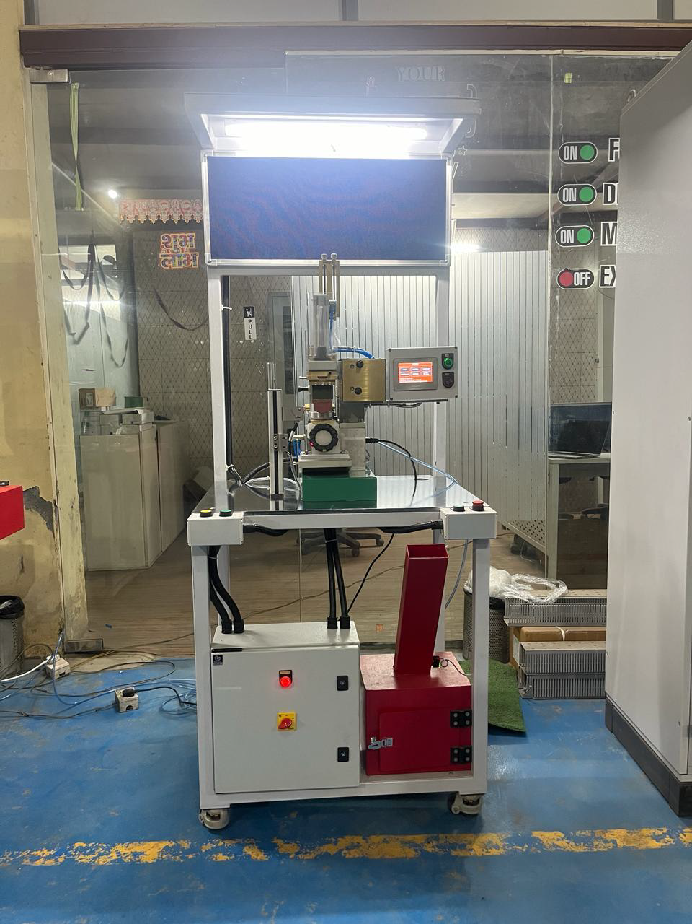
Machine Name-
PAD PRINTING MACHINE
Application – .
PRINT 10X10 MM SQUARES
ishikawatechnologypvtltd@gmail.com
info@ishikawatechnology.com

Slide 31
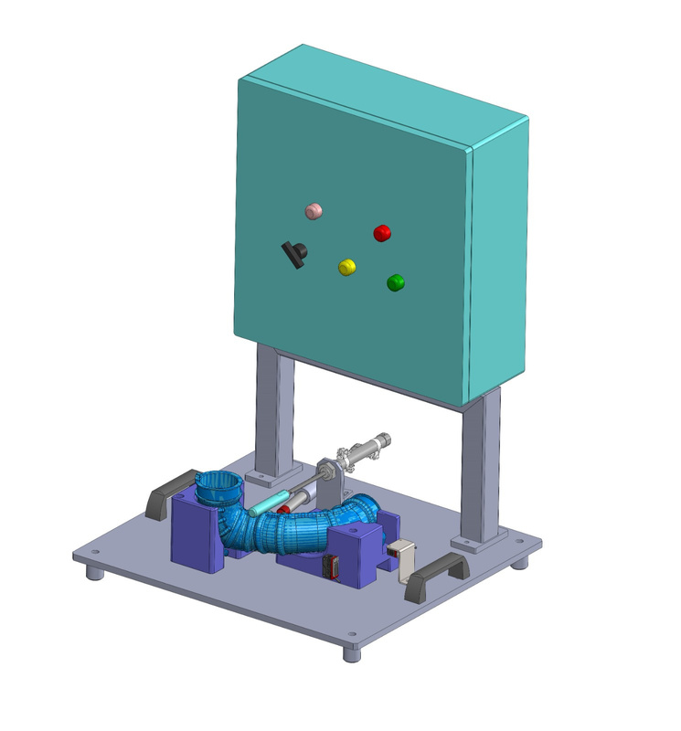
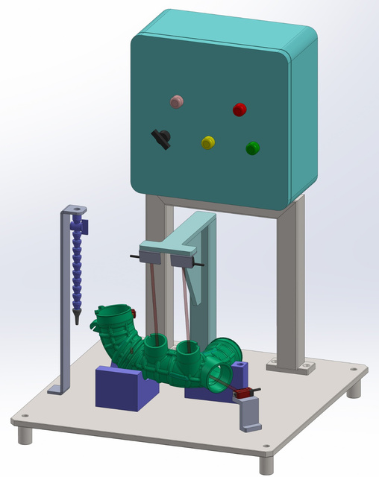
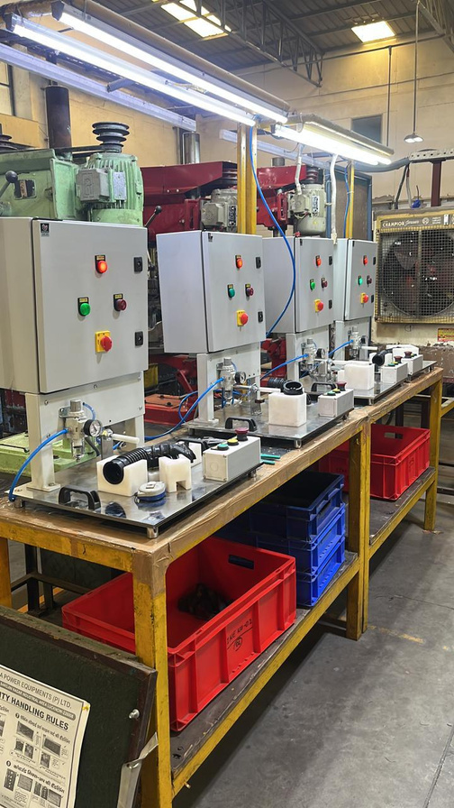
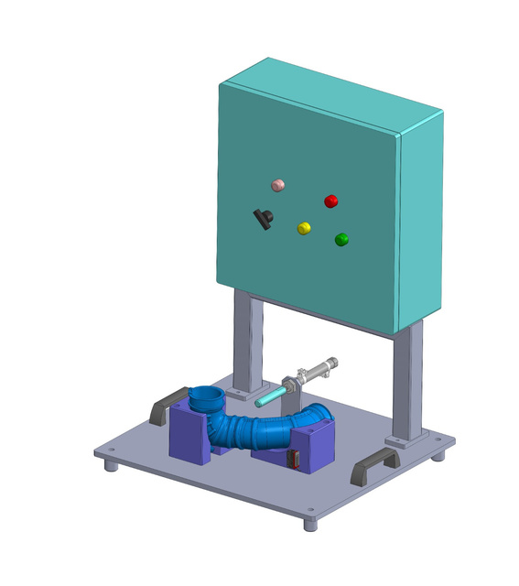
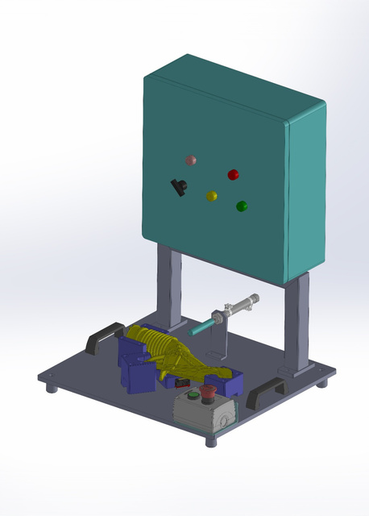
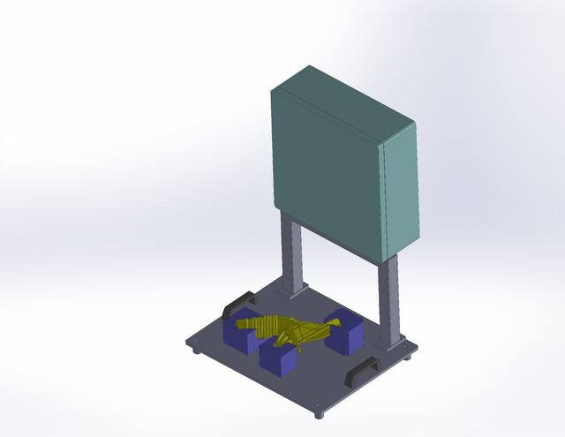
Machine Name-
HOSE BUSH CHECKING AND DOT MARKING
ishikawatechnologypvtltd@gmail.com
info@ishikawatechnology.com

Slide 32
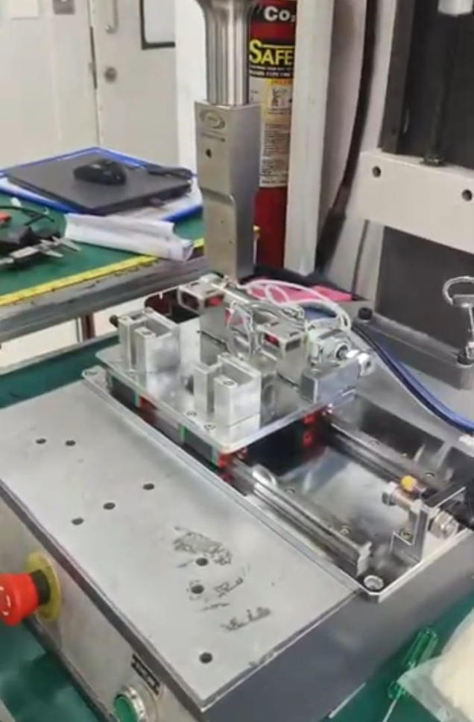
Machine Name-
ULTRASONIC WELDING MACHINE AUTOMATION
ishikawatechnologypvtltd@gmail.com info@ishikawatechnology.com

Slide 33
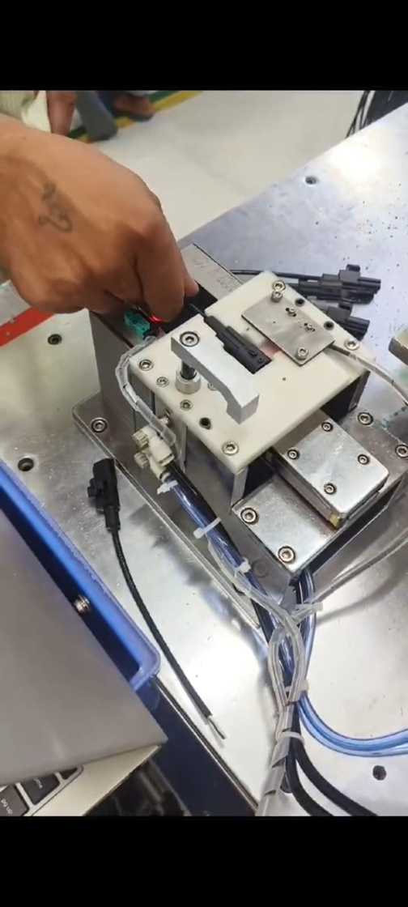
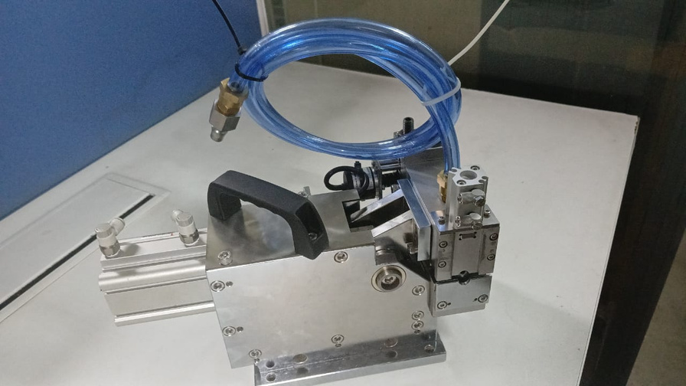
Machine Name-
CONNECTORE
CLIP ASSEMABALY
Machine Name-
GROMMET HEAD
ishikawatechnologypvtltd@gmail.com
info@ishikawatechnology.com

Slide 34
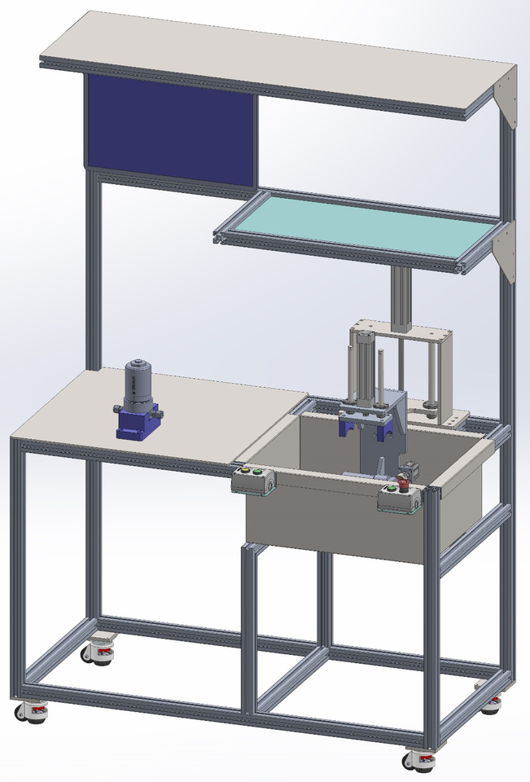
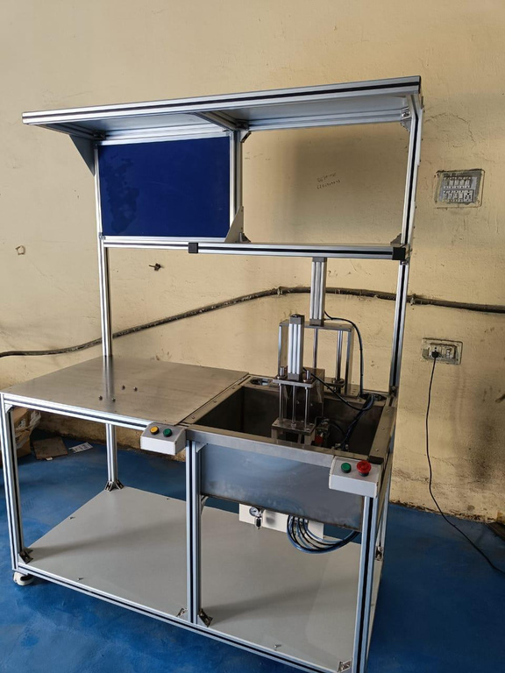
Machine Name-
LEAK TESTING
MACHINE
ishikawatechnologypvtltd@gmail.com
info@ishikawatechnology.com

Slide 35
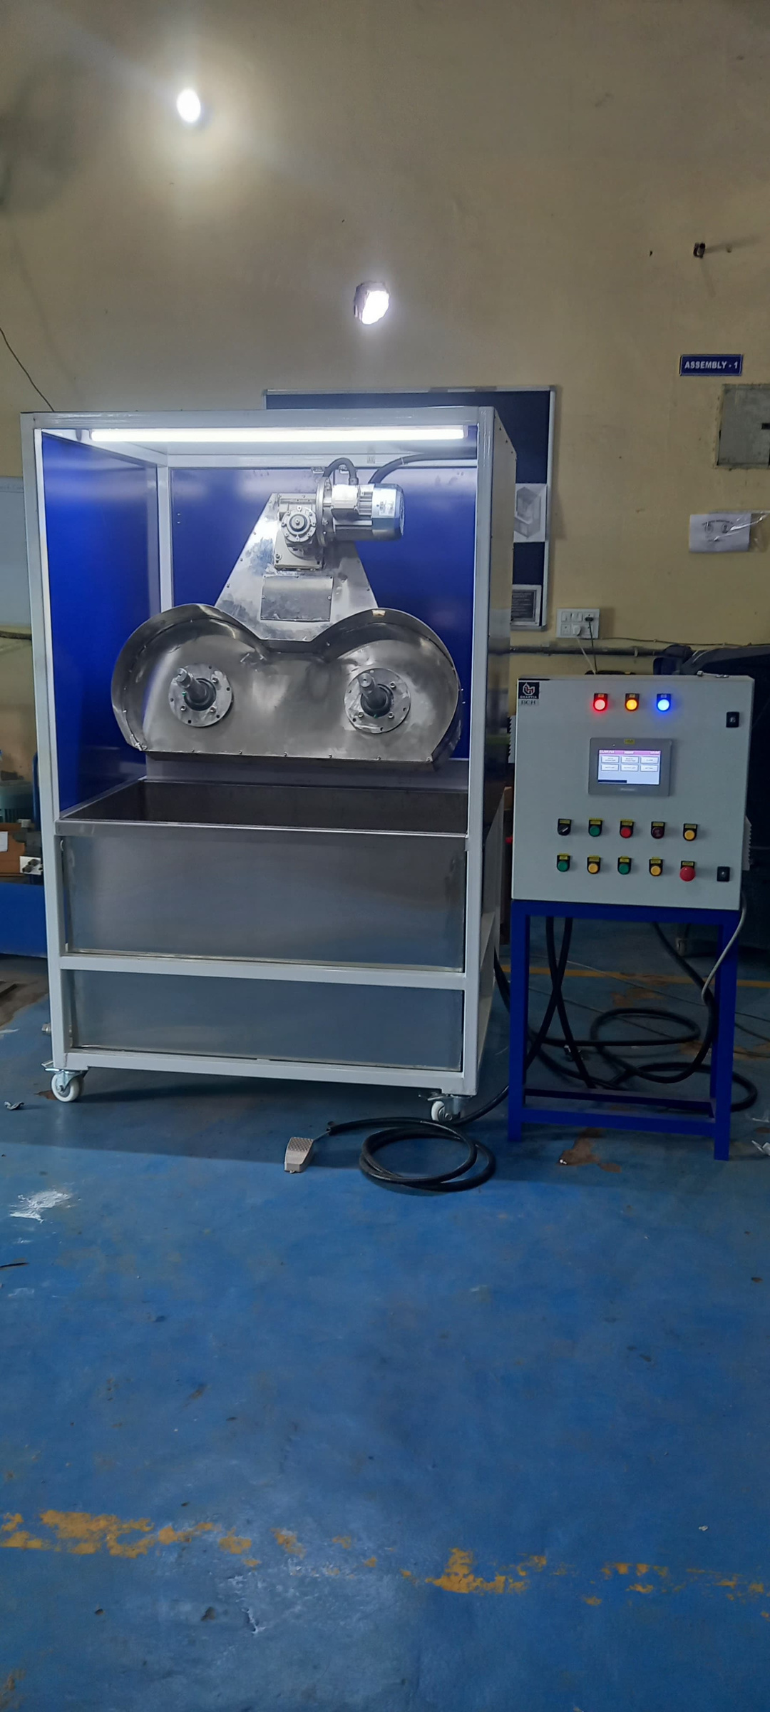
Machine Name-
DIPPING MACHINE
ishikawatechnologypvtltd@gmail.com
info@ishikawatechnology.com

Slide 36
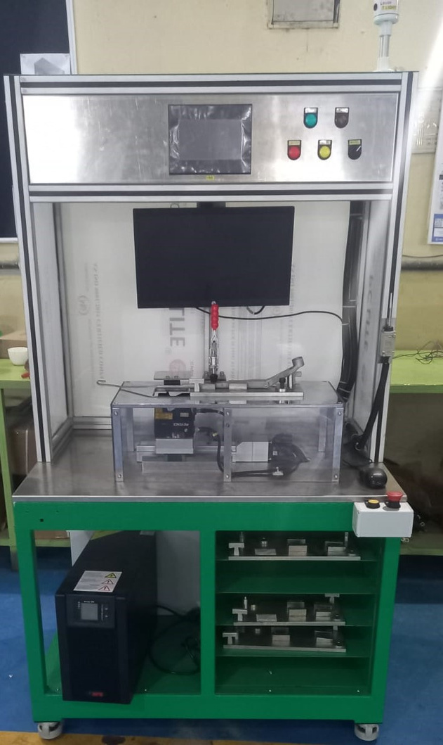
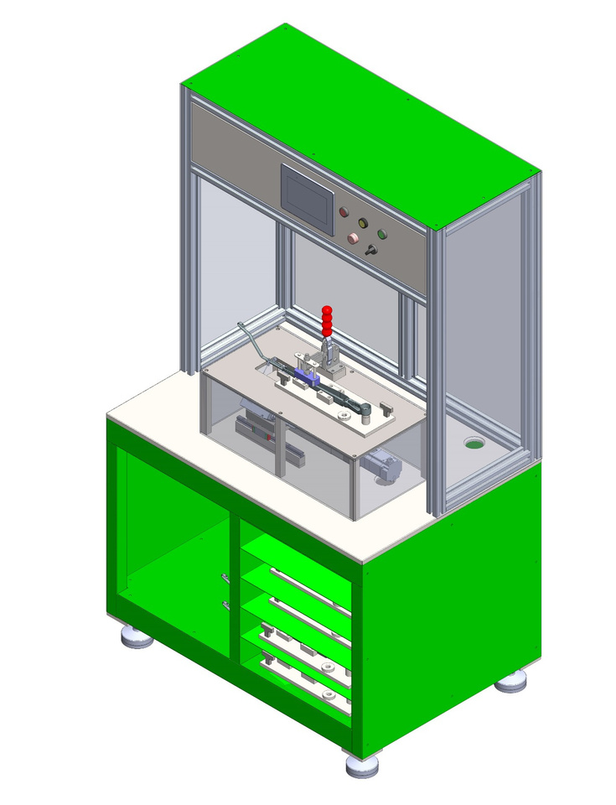
Machine Name-
PROFILE CHECKING MACHINE
ishikawatechnologypvtltd@gmail.com
info@ishikawatechnology.com

Slide 37
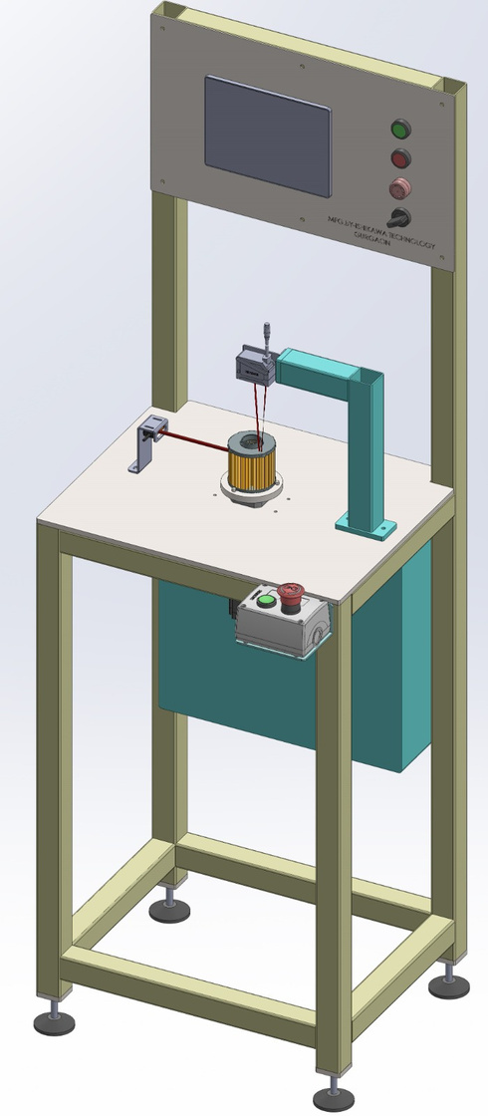
Machine Name
ELEMENT HEIGHT CHECKING MACHINE
ishikawatechnologypvtltd@gmail.com
info@ishikawatechnology.com

Slide 38
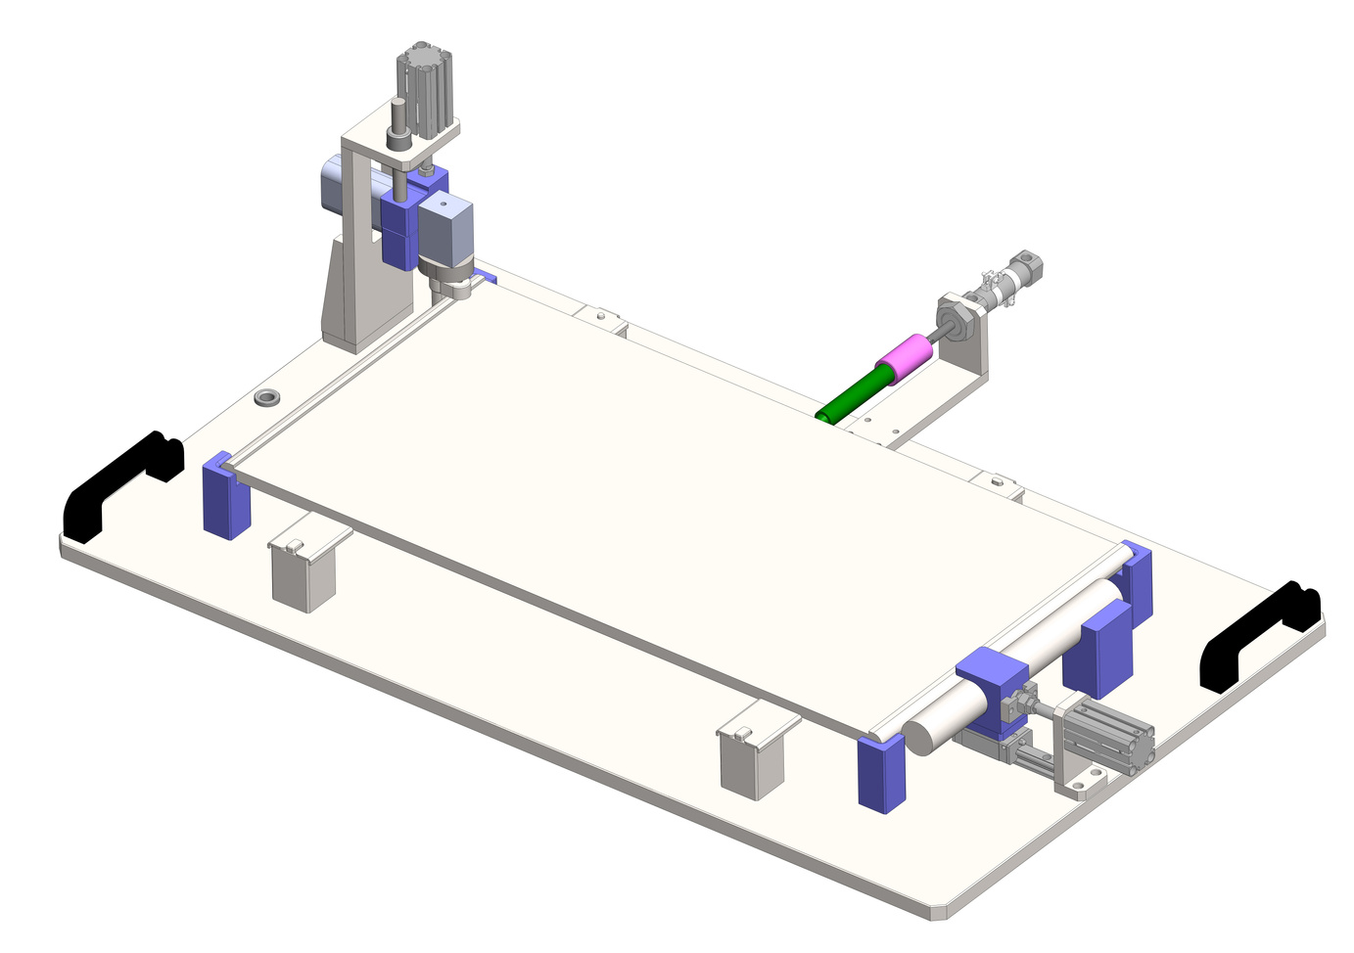
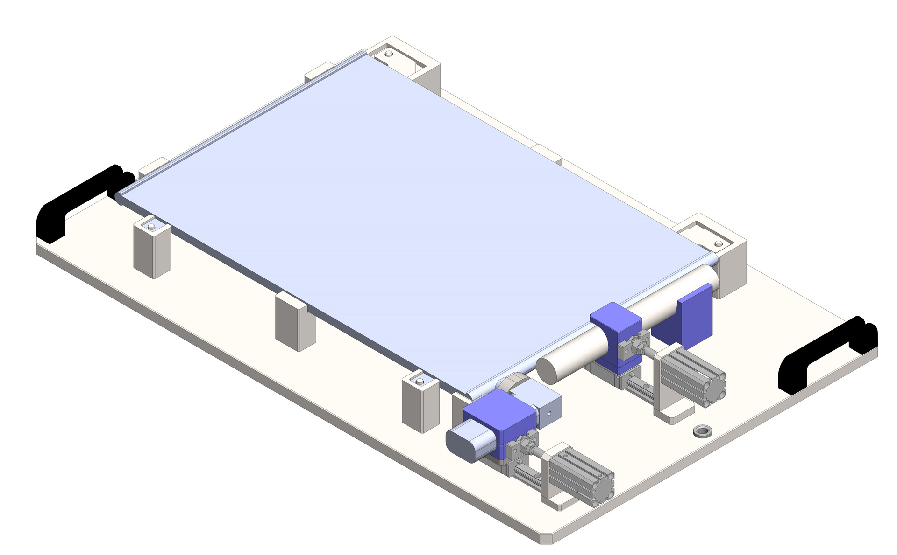
Machine Name
POKA YOKA FIXTURE
ishikawatechnologypvtltd@gmail.com
info@ishikawatechnology.com

Slide 39
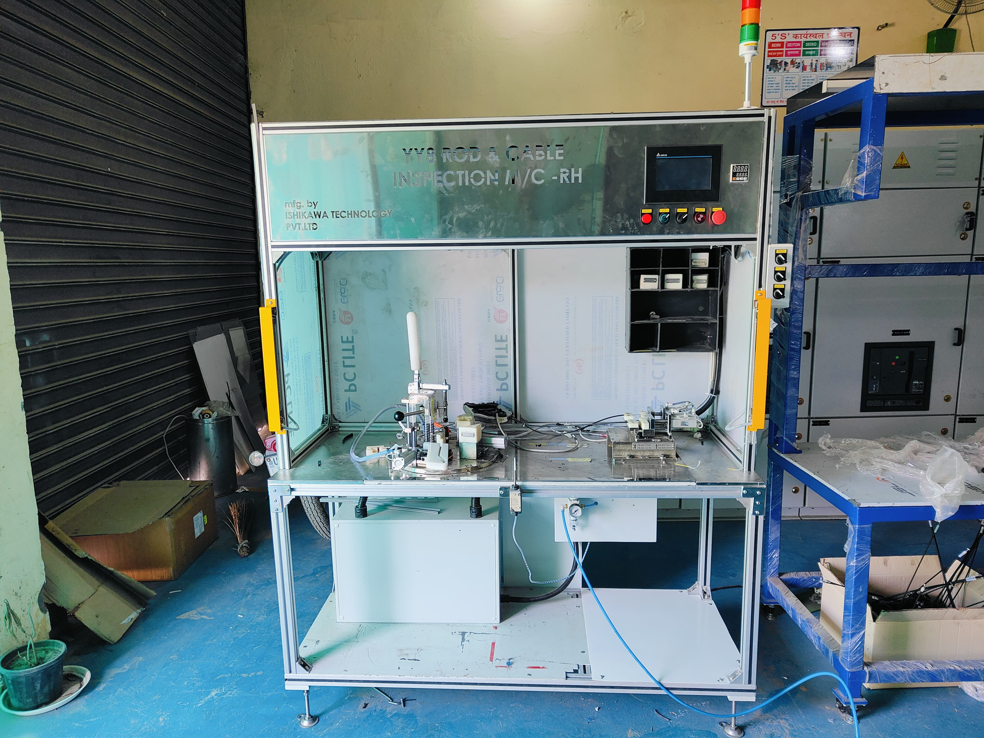
Machine Name
YY8 JIG & ROD CABLE INSPECTION MACHINE
ishikawatechnologypvtltd@gmail.com
info@ishikawatechnology.com

Slide 40
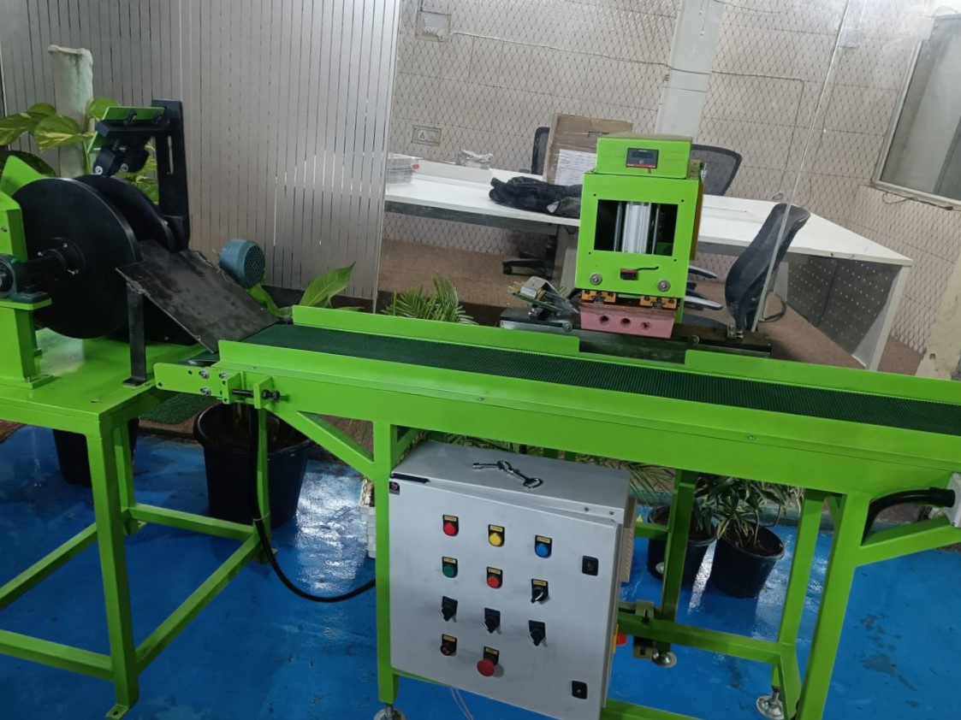
Machine Name
PAD PRINTING MACHINE
ishikawatechnologypvtltd@gmail.com
info@ishikawatechnology.com

Slide 41
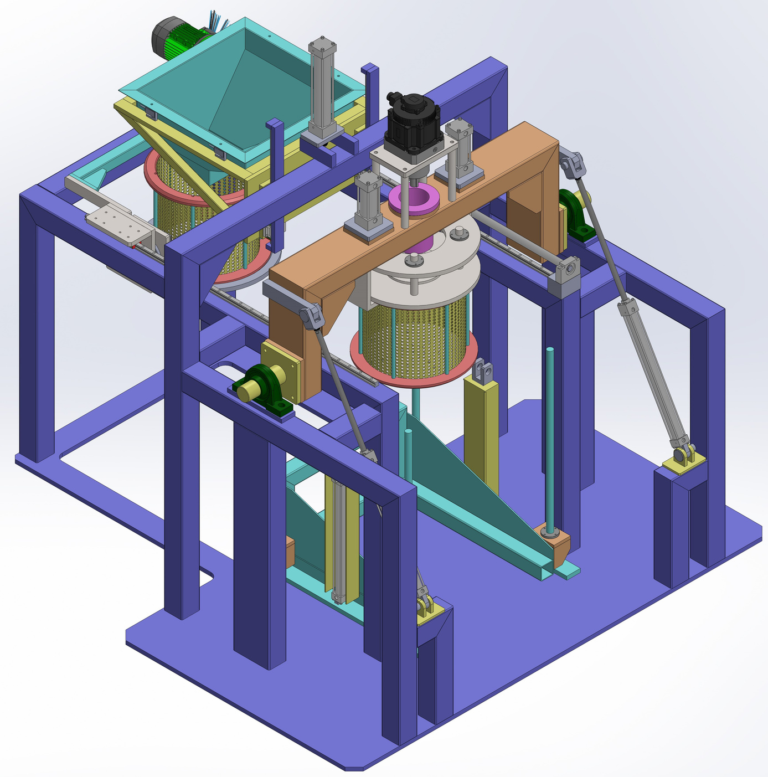
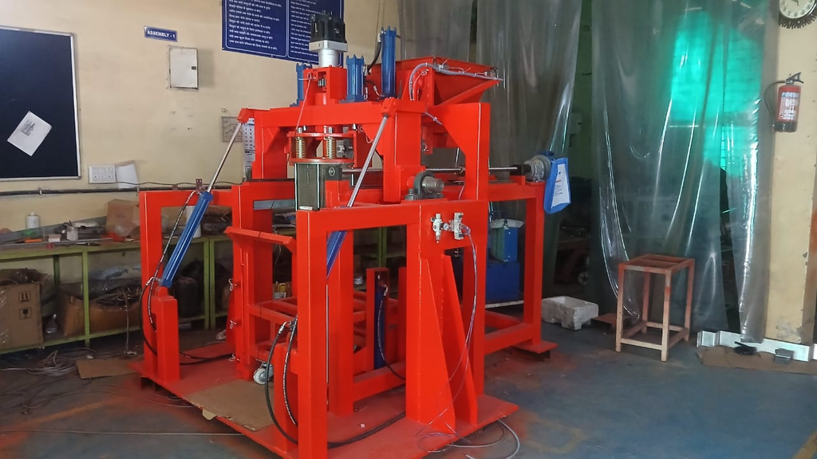
Machine Name
SPIN MACHINE
FOR ADMAS SURFACE FINISHERS
ishikawatechnologypvtltd@gmail.com
info@ishikawatechnology.com

Slide 42

Machine Name
LEAK TESTING MACHINE
ishikawatechnologypvtltd@gmail.com
info@ishikawatechnology.com

Slide 43



PAINT SHOP CONTROL PANEL
ishikawatechnologypvtltd@gmail.com
info@ishikawatechnology.com

Slide 44


PAINT SHOP CONTROL PANEL
ishikawatechnologypvtltd@gmail.com

Slide 45


PAINT SHOP CONTROL PANEL
ishikawatechnologypvtltd@gmail.com
info@ishikawatechnology.com

Slide 46



Facilities
Available Facilities & Infrastructure
Design office
Machine Shop Floor.
Tool Room
Fabrication Area
Semi Auto Milling Machine
Lathe Machine
Grinder Machine
Camera inspection
laser marking machine
ishikawatechnologypvtltd@gmail.com
info@ishikawatechnology.com

Slide 47




Data Traceability Programming & Vision Trails
ishikawatechnologypvtltd@gmail.com
info@ishikawatechnology.com

Slide 48



DESIGN OFFICE
ishikawatechnologypvtltd@gmail.com
info@ishikawatechnology.com

Slide 49


OFFICE
ishikawatechnologypvtltd@gmail.com
info@ishikawatechnology.com

Slide 50

STORE
ishikawatechnologypvtltd@gmail.com
info@ishikawatechnology.com

Slide 51



ASSEMBLY AREA
ishikawatechnologypvtltd@gmail.com
info@ishikawatechnology.com

Slide 52


Contact us
ISHIKAWA TECHNOLOGY PVT LTD
Plot No.1 ,Main Gadauli road, near Rama Garden Basai Enclave, Gurugram Haryana 122006
+91-8077344649 ,+91-8708007163 ,
+91-9416941008, +91-9756374204
ishikawatechnologypvtltd@gmail.com
info@ishikawatechnology.com

